Slide 1
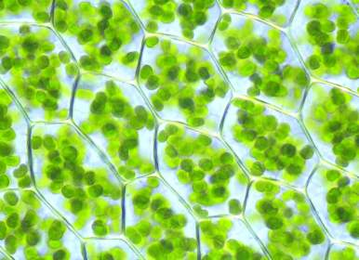
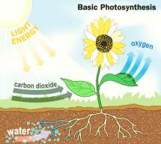

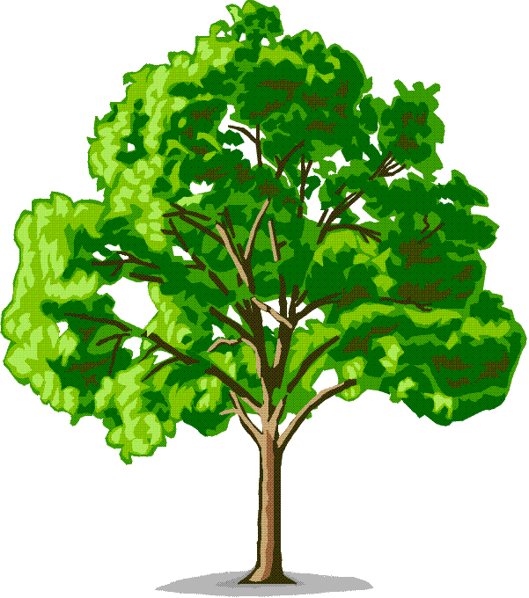
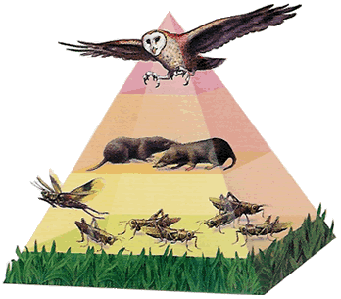
Photosynthesis
Sunshine plays a bigger role in our lives than you may think. All the food we eat and the fossil fuels we burn are products of photosynthesis.
Plants turn solar energy into food
which is nice of them because animals can’t eat sunshine.
When animals eat plants and other animals, that original solar energy is passed along the food chain.
Notes:
Note: The picture on the left is of plant cells under a light microscope and the chloroplasts are visible as green circles. The structure of chloroplasts will be covered on slide 7.

Slide 2
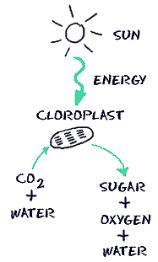
Photosynthesis is the process that converts solar energy into chemical energy that is used by biological systems (that means us).
Photosynthesis has 3 major events:
Sunlight is converted into chemical energy
Water (H₂O) is split into oxygen (O₂)
Carbon dioxide (CO₂) is fixed into sugars (C₆H₁₂O₆)
The photosynthesis reaction:
6 CO₂ + 12 H₂O + sunlight → C₆H₁₂O₆ + 6 H₂O + 6 O₂
6 Carbon
dioxide
molecules
12 Water
molecules
1 Sugar
(glucose)
molecule
6 Water
molecules
6 Oxygen
molecules
Notes:
Note: A more in depth look at each molecule in the reaction is covered on slide 6.

Slide 3
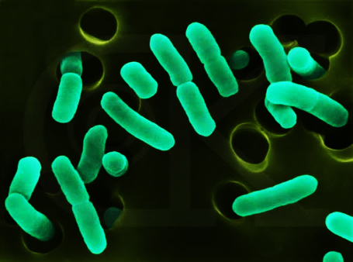
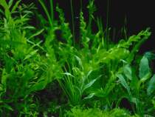
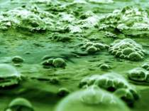
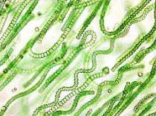
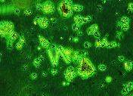
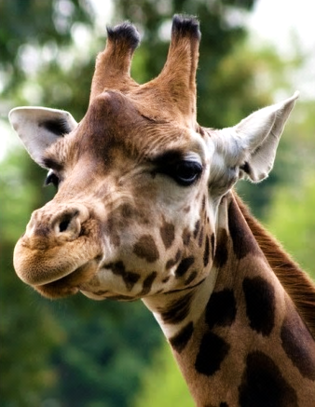
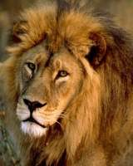
Photosynthesis is carried out by:
certain bacteria
plants
These organisms are known as photoautotrophs or producers meaning they make their own food and energy from the sun.
most algae
cyanobacteria
phytoplankton
Consumers such as herbivores and carnivores depend on the products of photosynthesis that producers make to live.

Slide 4
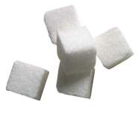
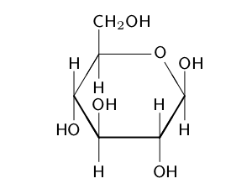
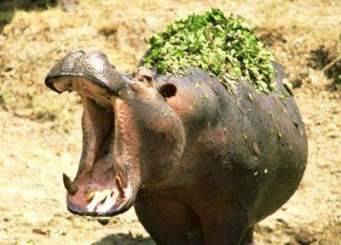
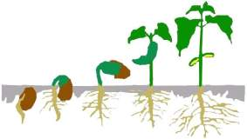
Glucose
Glucose (C₆H₁₂O₆) is a sugar and its molecular structure looks like this.
During photosynthesis, plants produce glucose molecules when they convert light energy into chemical energy. The chemical energy is stored in the bonds of glucose.
Plants produce sugars as a source of food. However, they produce way more than they need to survive. This is a great benefit for all the species that depend on glucose for energy.
Plants also use the glucose they produce for energy. When plants produce excess glucose they store it in their leaves.
All biological energy comes from glucose.
When animals digest plants, they are breaking down the glucose bonds to release stored energy to power their bodies.
Notes:
Note: Hippos are the most dangerous herbivore in Africa. Their powerful jaws can bite adult crocodiles in half! If you ever come across a hippo run away.

Slide 5


Glucose in Plants
Plant Chef
Why do plants make glucose?
What is it plants do with glucose?
“My masterpiece!”
Glucose molecules can be broken apart for energy to power reactions.
Glucose
Plants can also make glucose into carbohydrate chains called polysaccharides.
poly = many
saccharide = carbohydrate
Glucose is a simple sugar because it is one of the smallest units of carbohydrates.
Glucose is a monosaccharide.
Glucose
mono = one
saccharide
There are 2 polysaccharide chains in plants:
Cellulose Starch
Cellulose is the structural component of cell walls.
Starch is a long term energy store that the plant can use later.
O
O
O
O
O
O
O
O
Notes:
Note: The difference between cellulose and starch since both are made up entirely of several glucose molecules is where they bond to each other. Notice in cellulose the CH₂OH chain is always at the top but in starch the chain alternates top to bottom.

Slide 6

Each atom’s movement can be traced through the photosynthesis reaction.
Each letter stands for the element the atom is made of, so the letter C means an atom of carbon.
6
C
12.01
1
H
1.008
8
O
16.00
A water molecule has 2 hydrogen and 1 oxygen atoms.
One molecule of glucose (sugar) has 6 carbon, 12 hydrogen and 6 oxygen atoms.
A carbon dioxide molecule has 1 carbon and 2 oxygen atoms.
The sunlight provides the energy for the reaction.
6 CO₂ + 12 H₂O + sunlight → C₆H₁₂O₆ + 6 H₂O + 6 O₂
Carbon
Hydrogen
Oxygen
Before
After
6 carbon atoms
6 carbon atoms
If 6 carbon dioxide molecules are used there are 6 carbon atoms and 12 oxygen atoms total (6 x 2 = 12).
If 12 water molecules are used there are 24 hydrogen atoms (12 x 2 = 24) and 12 oxygen atoms total.
12 oxygen atoms
12 hydrogen atoms
6 oxygen atoms
24 hydrogen atoms
12 hydrogen atoms
12 oxygen atoms
6 oxygen atoms
12 oxygen atoms
If you count every atom before and after the reaction they are balanced.
6 oxygen atoms
24 oxygen atoms
24 hydrogen atoms
6 oxygen atoms
24 oxygen atoms
24 hydrogen atoms
Notes:
ANIMATION: There is a ton of animation on this slide to help walk the students through reading chemical formulas.
First – each letter stands for the element in the periodic table the atom is made of. A group of letters together (e.g. H₂O) means there are two H hydrogen atoms and one O oxygen atom in each molecule. The molecules used in this equation are carbon dioxide, water, glucose, and oxygen.
Second – if there is a big number before a molecule it is the number of each molecule e.g. 6 H₂O means 6 water molecules and since there are 2 hydrogen atoms and 1 oxygen atom per molecule, 6 water molecules has 12 hydrogen atoms (6x2=12) and 6 oxygen atoms (6x1=6).
Note: The molecules in a reaction before the conversion takes place are called “reactants” if you’d like you can change the “Before” label in the table to “Reactants.” After a reaction has taken place the reactants are changed into new molecules and these are called “products” you can change the “After” label in the table to “Products.” Reactants are the starting materials for a reaction and products are the ending materials at end of the reaction.

Slide 7
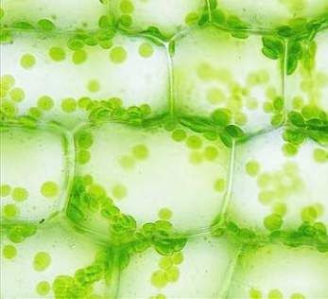
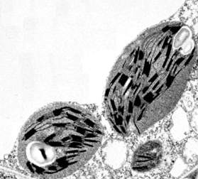
Through evolution, plant cells, certain bacteria and some algae have acquired chloroplasts to help carry out the photosynthetic reaction.
Chloroplasts are a plastid or plant cell organelle.
Chloroplasts are full of round flattened discs called thylakoids.
A stack of thylakoids is called a granum.
Both pictures are of chloroplasts in plant cells at different magnifications.
Chloroplast
Stroma is the space inside chloroplasts
Chloroplasts are where photosynthesis occurs.
Notes:
Note: The chloroplast picture on top was taken with a light microscope with a magnification of about 100x. The bottom picture of chloroplasts was taken with an electromagnetic microscope which has a magnification range up to 10,000,00x.
Emphasize the terms thylakoid and stroma as these are where the reactions take place.

Slide 8
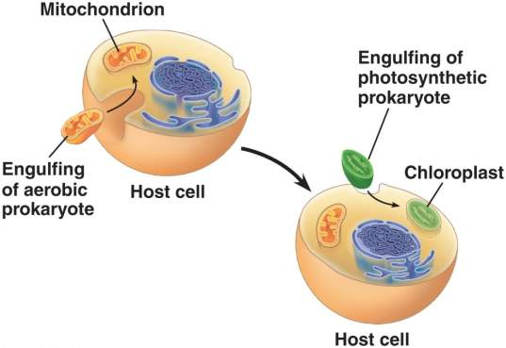
Where did chloroplasts come from?
A very long time ago, plant cells were once ancient eukaryotic cells that had enveloped a cyanobacteria. Eventually, the cyanobacteria became a part of the cell and dependent upon it for life which in turn gave the cell the ability to photosynthesize.
Mitochondria are also believed to have been engulfed by ancient eukaryotic cells through endosymbiosis.
This is called the endosymbiotic theory.
(endo = inside)
Plant DNA
There are many reasons why scientists believe this theory.
One is that chloroplasts have their own DNA that is different from plant DNA but similar to bacterial DNA.
Bacterial DNA
Chloroplast DNA
Notes:
YouTube Video: Before or after covering the text on the slide click on the “Where did chloroplasts come from?” link to a great YouTube video called “Evolution and Oxygen” that is 9:29 minutes long and covers the complete history. Once the video is finished there is animation on the slide, click to make the last paragraph appear that covers one piece of evidence for the endosymbiotic theory.
Note: Prokaryotes are cells without a nucleus and these include all bacteria. The difference between bacterial DNA and plant DNA is that prokaryotes do not contain their DNA in a nucleus and is free floating. Plants are eukaryotes which means their DNA is contained in a nucleus (represented by the purple circle in the slide).

Slide 9
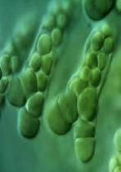
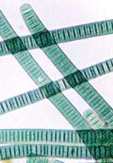
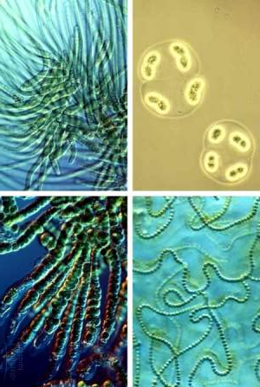
Cyanobacteria Today
Cyan comes from the Greek word cyanin which means aqua colored.
Not all bacteria that undergo photosynthesis are cyanobacteria but all cyanobacteria are photosynthetic bacteria e.g. purple bacteria are not cyanobacteria but were the first bacteria discovered that can photosynthesize.
Cyanobacteria undergo photosynthesis in lakes, ponds, and oceans.
Cyanobacteria lack chloroplasts - why do you think that is?
Notes:
Question for class: Cyanobacteria lack chloroplasts – why?
Answer: Because the organelle chloroplasts originated from cyanobacteria that were absorbed by eukaryotic (ancestral plant) cells.

Slide 10
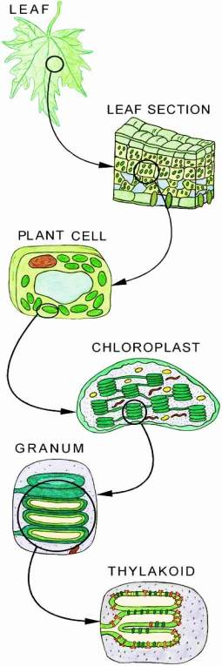
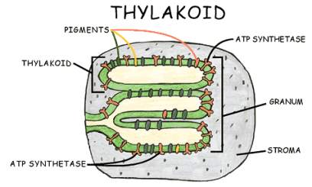
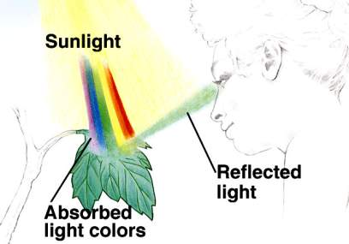
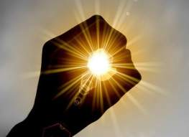
Photosynthesis in plants happens in the chloroplasts.
Chloroplasts are full of thylakoids stacked in granum.
The thylakoid membranes are lined by pigments such as chlorophyll and cartenoids.
Chlorophyll is a green pigment and is the most abundant.
Chlorophyll absorbs all wavelength colors except green, which is reflected off giving plants their green appearance.
These pigments harvest light energy packets or photons when they absorb sunlight.
Notes:
Note: Trace through the zoomed in plant leaf diagram on the left from the leaf to thylakoids to give students a sense of where the thylakoids are in the plant and how small they are.

Slide 11
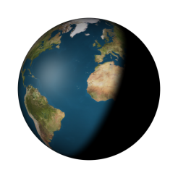
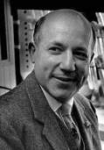
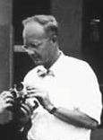
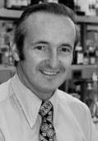
The Photosynthesis Reaction is divided into two parts:
Light Reactions
Dark Reactions
Light reactions or
“light dependent reactions”
capture light energy to power photosynthesis.
Light reactions occur during the day time.
They take place in the thylakoids.
Dark reactions or “light independent reactions” do not need light energy to power their reactions and can occur day or night.
Discovered by three scientists, the dark reactions are also called the Calvin-Bensen-Bassham cycle or just Calvin Cycle.
Dark reactions occur in the stroma of chloroplasts (the space that surrounds thylakoids) and fix carbon dioxide into glucose.
Pigments in the thylakoid membranes form protein complexes called Photosystem I and Photosystem II.
These photosystems harvest photons to charge up energy carrying molecules that will power the dark reactions.
C
B
B
Notes:
Note: Remind students that dependent means “requires or needs” and independent means “stand alone or doesn’t need.”
So light dependent reactions require or needs light to occur and the light independent reactions do not need light to take place.

Slide 12

Energy Carrying Molecules: ATP & NADP+
adenosine triphosphate
Both are energy carrier molecules used in photosynthesis and cellular respiration.
“ATP”
A
P
P
P
NADP+ can hold excited electrons (e⁻) charged from the light energy harvested by chlorophyll to become NADPH.
Eventually, NADPH passes the electron it’s holding to power the dark reactions and reverts back to NADP+.
R
three phosphate groups
adenosine =
adenine + ribose
ATP is called the “cellular currency” because it is used to power all the reactions that take place in the cells of all living things.
nicotinamide adenine dinucleotide phosphate
N
“NADP+”
When ATP’s third phosphate is broken off it releases energy that the cell can use.
P
P
A
R
R
ATP is made when a third phosphate group is added to ADP (diphosphate, di = two).
P
NADP is a very complex molecule, this is a simplification.
Notes:
Note: When NADP+ holds the excited electron which has a negative charge it attaches to a proton, or a single Hydrogen atom with a positive charge, hence the H at the end of NADPH. Reactions we need ATP for transporting molecules across membranes, cell division, cell movement, and production of proteins.

Slide 13
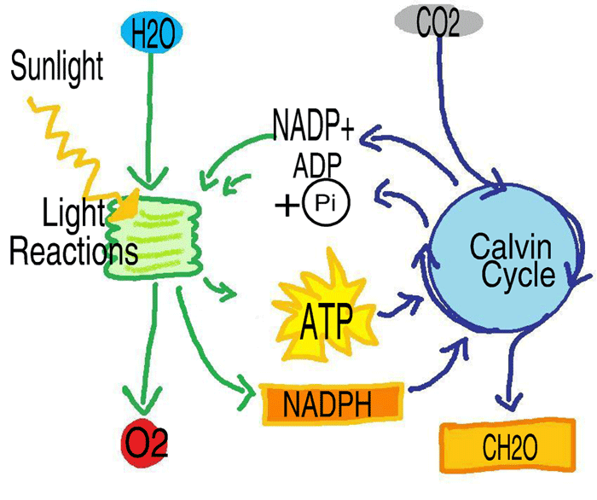
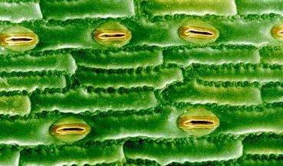
Light Reactions
The energy absorbed by the chlorophyll during the light reactions is used to power photosystem II that breaks the bonds of water absorbed through the plant’s roots.
Photosystem II
THYLAKOID
PSII
Freed oxygen atoms bind with each other to form the gas O₂.
_
O
_
O
H
H
O₂
O₂ is a byproduct of photosynthesis not used by the plant so it is released through the stomata of plants.
Stomata (Greek for mouth) are little pores in leaves that open and close to let oxygen out and carbon dioxide in.
O₂
Notes:
Note: Only one photosystem II protein complex is shown in the thylakoid membrane but there are actually many in each thylakoid membrane of each granum in every chloroplast of each plant cell so photosynthesis involves many molecules of each product.

Slide 14

Light Reactions
When water molecules break apart, the remaining two hydrogen atoms have a positive charge and are called protons. These protons are kept inside the thylakoid by the thylakoid membrane.
THYLAKOID
H+
H+
H+
H+
H+
H+
H+
H+
When there are more protons inside the thylakoid than in the stroma outside, protons want to leave the crowded thylakoid.
ATP maker
When the protons (H+) cross the membrane to leave, a protein uses their passage to power ATP production.
The protein ATP synthase attaches a phosphate group to ADP (D = di or two) making it ATP (T = tri or three).
Notes:
Note: The movement of protons across the thylakoid membrane is due to a proton concentration gradient. When particles are more crowded in one area they tend to flow away to a less crowded area. You can see this by adding a drop of food coloring to a cup of water, the dye disperses until the particles are evenly dispersed throughout so that no one area is more crowded than the other. “Crowded” is a hyperlink that leads to a YouTube video explaining exactly how proton concentration gradients are used to power ATP synthase to make ATP in the mitochondria.

Slide 15
Light Reactions
The light energy absorbed by chlorophyll also powers photosystem I that charges up the energy carrier molecule NADP+ into NADPH.
NADP+
NADPH
THYLAKOID
PSII
PSI
NADPH then carries its energy over to power the dark reactions or Calvin Cycle.

Slide 16
Light Reactions Summary
NADP+
NADPH
THYLAKOID
PSII
PSI
Photons are absorbed by the pigments to power photosystem I and photosystem II.
_
O
_
H
H
Photosystem II splits water molecules into two protons (H+) and oxygen atoms are expelled as O₂ gas through the stomata.
ATP maker
Protons cross the thylakoid membrane and power protein complex ATP synthase to make ATP.
NADP+ is powered up by photosystem I to make NADPH to be used in the dark reactions.
Light dependent reactions finish with charged NADPH, ATP, and released O₂.
Notes:
Note: YouTube hyperlink “light dependent reaction” 6:35 this video explains light dependent reactions and goes more into depth than the PowerPoint.

Slide 17
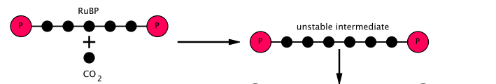
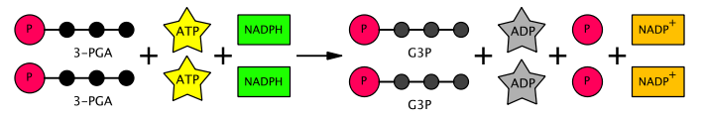
Dark Reactions
Also called the Calvin Cycle, the dark reactions start and end with the same products hence “cycle”.
All the dark reactions take place in the stroma of the chloroplast.
The Calvin Cycle starts with RuBP molecules and carbon dioxide molecules. An enzyme called Rubisco combines them into an unstable intermediate.
RuBP
Rubisco
CO₂
Since the intermediate of combined RuBP and CO₂ is unstable it quickly splits in half and forms 2 molecules of 3-PGA which are stable.
This is the reason plants take in carbon dioxide, to start the Calvin Cycle and begin the conversion of RuBP into glucose.
RuBP is the starting molecule and ending molecule of the Calvin Cycle. It will be remade at the end of the cycle so that the cycle can begin again.

Slide 18

Dark Reactions
The ATP and NADPH from the light reactions provide the energy to convert the two molecules of 3-PGA into their final form G3P.
The left overs are reused in the light reactions to remake ATP and NADPH.
2 G3P are joined to make a glucose molecule.
+
→

Slide 19
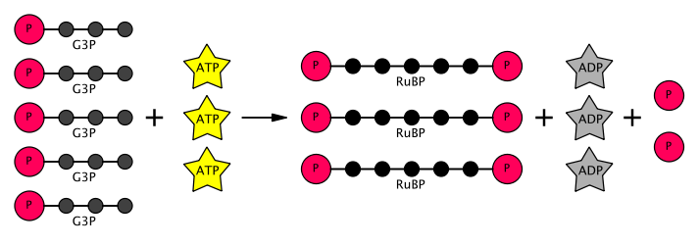
Dark Reactions
Not all G3P is made into glucose.
The Calvin Cycle occurs in every stroma in every chloroplast in every plant cell every second of every day.
That’s a lot of reactions all happening simultaneously!
The spent ATP from the reaction leaves ADP and a phosphate group. These are reused in the light reactions to make more ATP.
Most of the G3P made during the Calvin Cycle are made into RuBP, the starting molecule, with energy from ATP molecules.
Now the Calvin Cycle can begin again.

Slide 20
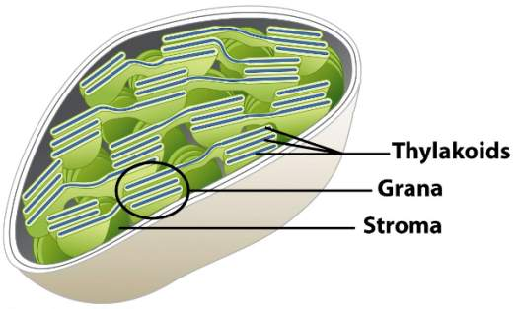
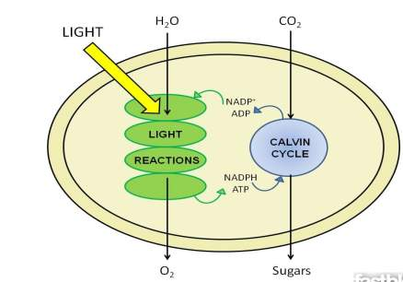
Dark Reactions
Summary
Chloroplast
The Calvin Cycle converts the carbon from carbon dioxide into glucose in the stroma. This is called carbon fixation because carbon is fixed into another form.
Photosynthesis is carried out in two steps.
First, in two light dependent photosystems. Second, in a light independent carbon fixation cycle called the Calvin Cycle. Through this process, the plant is able to convert sunlight, water, and CO₂ into glucose (or sugar) and ATP.
As a byproduct of this process, O₂ is released.
Notes:
Note: YouTube clip link at hyperlink “The Calvin Cycle” is 7:30 minutes long and covers the light independent or dark reactions or Calvin Cycle reactions more in depth. He does misspeak at the beginning of the video and says the light independent reactions stop when there is no light but this is incorrect the light dependent reactions stop when there is no light, the light independent reactions occur in the light or dark.

Slide 21
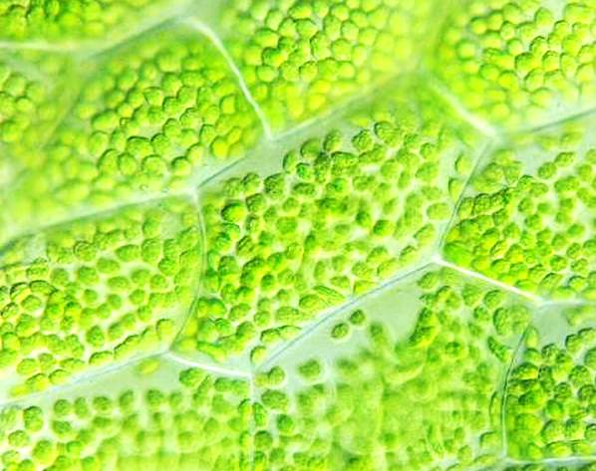
Summary
Plants are the producers of the biosphere creating the oxygen and glucose needed for most organisms.
Chloroplasts are the site of photosynthesis in plants.
Chloroplasts contain thylakoids where the light reactions take place.
Light reactions convert sunlight into ATP and NADPH.
The dark reactions or Calvin Cycle uses ATP and NADPH to convert CO₂ into sugar.
The light reactions and the dark reactions cooperate to convert light energy into chemical energy housed in glucose.
Plants and animals use glucose to power metabolic processes.
Notes:
Note: YouTube hyperlink at “Summary.” Video has no words, just a short video of water molecules being absorbed from roots, carbon dioxide molecules entering the stroma, and the conversion process. I would stop the video after 1:00, the first half shows the water molecules and carbon dioxide molecules entering the plants but the second half does not show the reactions happening in the thylakoids or stroma.

Slide 22
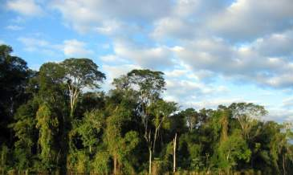
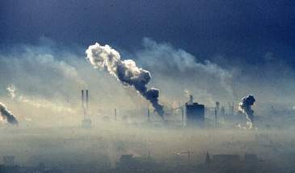
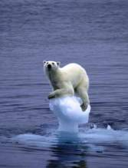
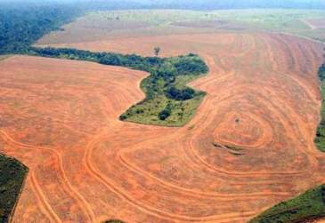
When plants absorb carbon dioxide from the air, they are removing carbon from the atmosphere and fixing carbon into forms usable by other organisms. The burning of fossil fuels for energy, releases carbon dioxide gas into the atmosphere increasing the amount of carbon in the atmosphere.
Human’s excessive dependence on fossil fuels has led to an increase in the level of CO₂, a green house gas that traps heat in the atmosphere and heats up the earth. The rate at which human’s are burning fossil fuels is too high for plants and oceans to take carbon out of the atmosphere.
Deforestation is a contributing factor to the excessive amounts of CO₂ in the atmosphere and is also due to human influence. With the destruction of entire forests every day, we reduce the number of plants available to reduce carbon in the atmosphere.
Notes:
Note: Oceans absorb carbon in the form of precipitation for more information see the Carbon Cycle.

Slide 23
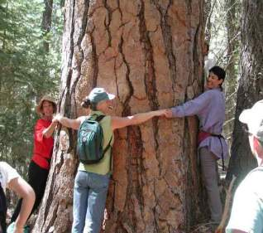
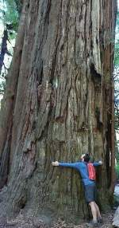
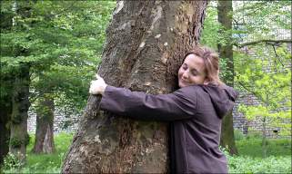
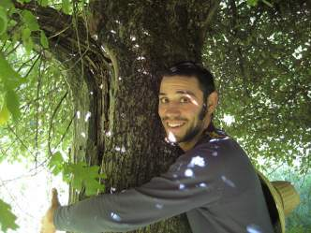

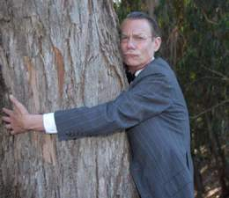
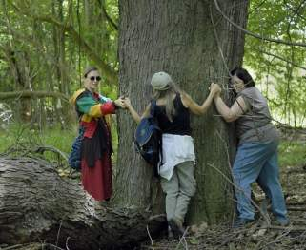
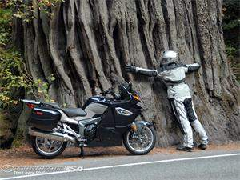

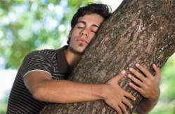




Go Out and Thank a Tree!

